Slide 1
Time Synchronization in Time Sensitive Networking (TSN)
Hesham ElBakoury
(11/4/2020)

Slide 2
AGENDA
TSN Introduction
Brief History of TSN
TSN Tools and Profiles
TSN Basic Components
TSN Management Models
Deterministic Data Center
TSN IEEE 802.1Qbv (Time Aware Shaper)
Schedule Computation using TSN fully centralized management model
IEEE 802.1Qbv in action
IEEE 802.1AS (gPTP) Overview
IEEE 802.1AS (IEEE 1588 Profile for TSN)
Best Master Clock Algorithm (BMCA)
Time Synchronization Protocols and Mechanisms
Multi-domain support in IEEE 802.1AS-Rev 2020.

Slide 3
TSN Introduction

Slide 4
Brief History of TSN
Initially Ethernet provides best effort service but does not support the transport of traffic that has stringent timing requirements (e.g. deterministic low latency)
Deterministic latency means that all frames of a given application trafﬁc ﬂow (connection) must not exceed a prescribed bound.
In general, despite the enormous successes and wide-spread adoption of Ethernet the Ethernet deﬁnitions lack the following aspects for supporting applications that require Low and deterministic latency:
Lack of QoS mechanisms to deliver packets in real time for demanding applications, such as real time audio and video delivery.
Lack of QoS mechanisms to support applications that require deterministic latency such as factory automation.
Lack of global timing information and synchronization in network elements.
Lack of network management mechanisms, such as bandwidth reservation mechanisms.
Lack of policy enforcement mechanisms, such as packet ﬁltering to ensure a guaranteed QoS level for an end-user.
Motivated by these Ethernet shortcomings, IEEE 802.1 WG has created the AV TG in 2005 which was renamed to be the TSN Task Group (TG) in 2012.
TSN is working on the standardization of the protocols and mechanisms to support low and deterministic latency with zero congestion loss.
If congestion is eliminated by pacing the delivery of packets and allocating sufficient buffer space for TSN flows, TSN can provide a given TSN flow a worst case latency for delivering its packets end-to-end.

Slide 6
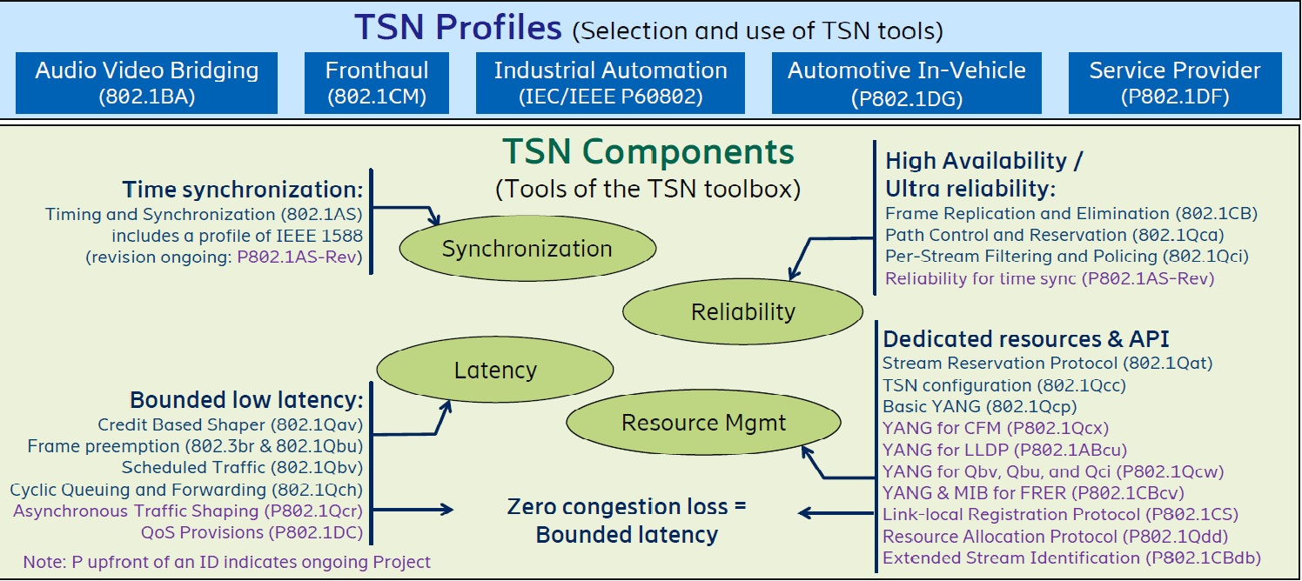
TSN Tools and Profiles
TSN Introduction, Janos Farkes, July 16th 2019.
IEEE 802.1
TSN TG is
Working on
A new PAR
to create
a new profile
for avionics
Ultra-Low Latency (ULL) Networks: The IEEE TSN and IETF DetNet Standards and Related 5G ULL Research
IEEE Communications Surveys & Tutorials
Year: 2019 | Volume: 21, Issue: 1 | Journal Article

Slide 7
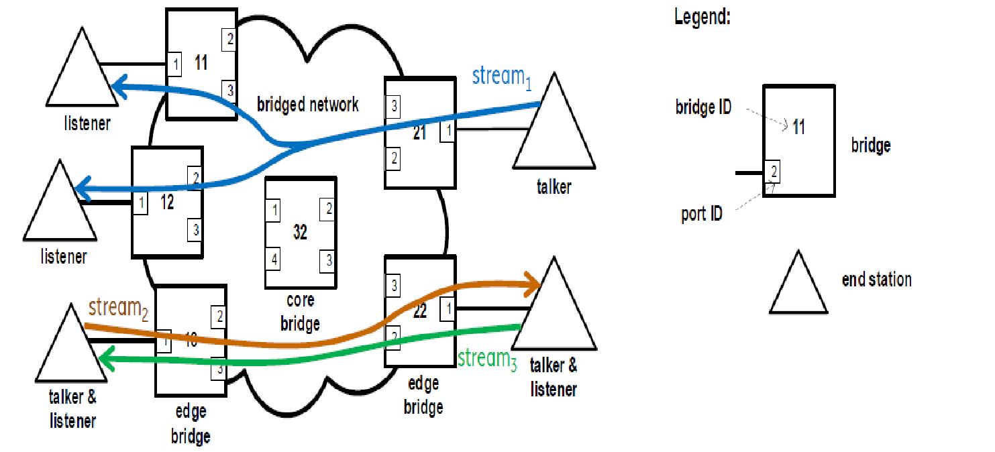
TSN Basic Entities
Stream: A unidirectional flow of data from a Talker to one or more Listeners

Slide 8
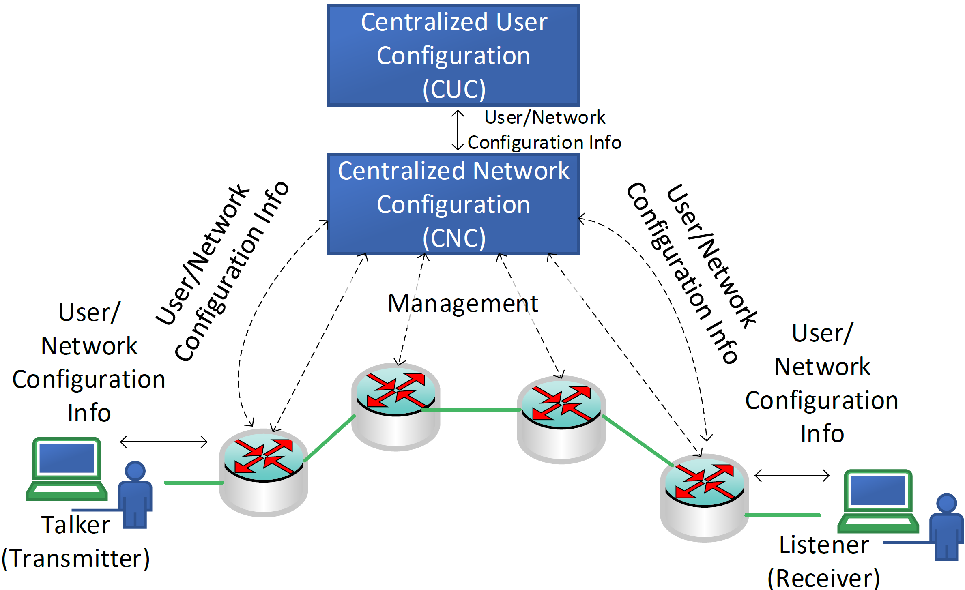
TSN Management Models
There are 3 models:
Fully distributed,
fully centralized, and
Hybrid,
Centralized User Configuration (CUC): A centralized entity that discovers end stations, retrieves end station capabilities and user requirements, and configures TSN features in end stations. The protocols that the CUC uses for communication with end stations are specific to the user application, not specified in the IEEE 802.Qcc standard. A CUC exchanges information with a CNC in order to configure TSN features on behalf of the end stations.

Slide 9
Steps to Compute IEEE 802.1Qbv Schedule
CNC Uses LLDP to discover the physical topology of the network.
CUC obtains the discovered topology from CNC.
Engineer uses this topology to identify all flow requests and the talker and listeners of each flow.
The engineer can also define the latency requirements for the communications (for example, the listeners must receive within 500μs from start of transmission), the maximum size of the Ethernet packet that will be sent, and other dependencies (e.g. whether there is a sequence order to the TSN flows).
The CUC will gather this information for all TSN flow requests and submit to the CNC using an API.
CNC uses this information along with link delays for each flow to compute the schedule which includes the start and end of the transmit window on each hop.
IEEE 802.1AS or other alternative method can be used to compute the link delay.
IEEE 802.1Qcc provides API that allows CNC to query the link delay.
CUC obtains the schedule to be verified by the engineer.
CUC issues a request to the CNC to distribute the computed schedule to the TSN bridges.
The CUC will also program the talkers and listeners for the TSN flows so that the talkers can transmit every TSN flow according to a schedule
TSN Technical Introduction, Cisco, 2017

Slide 10
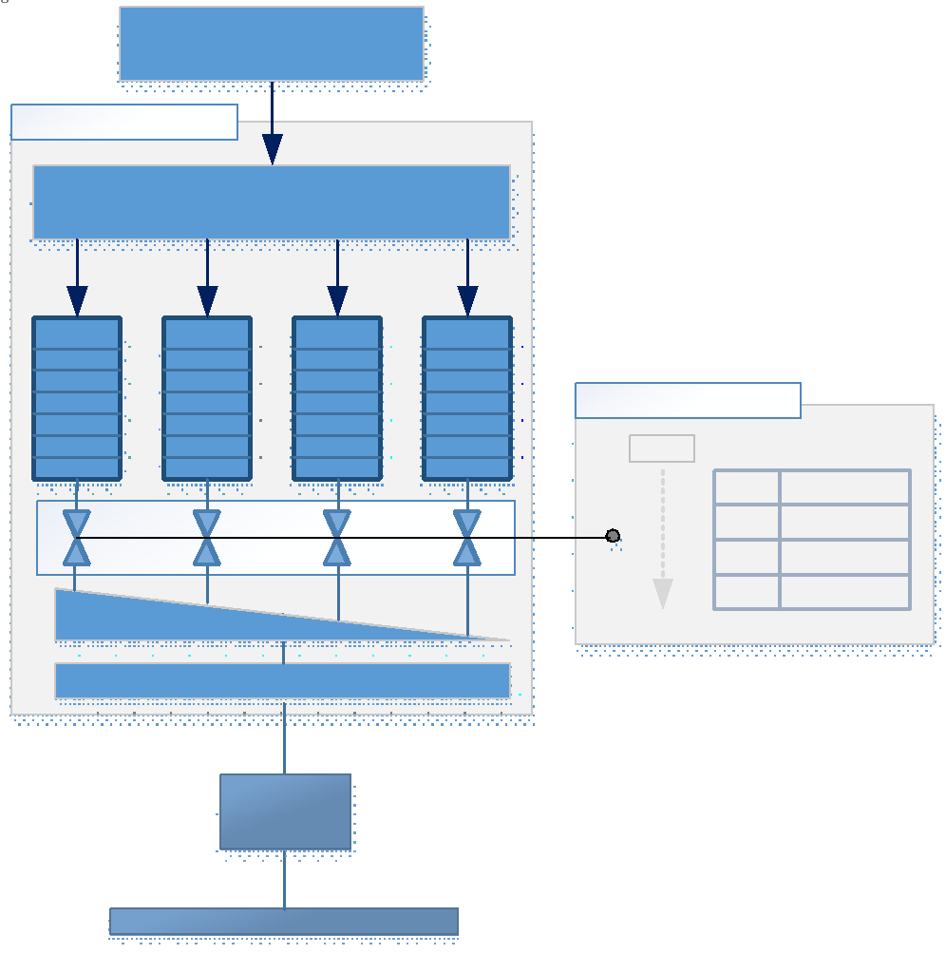
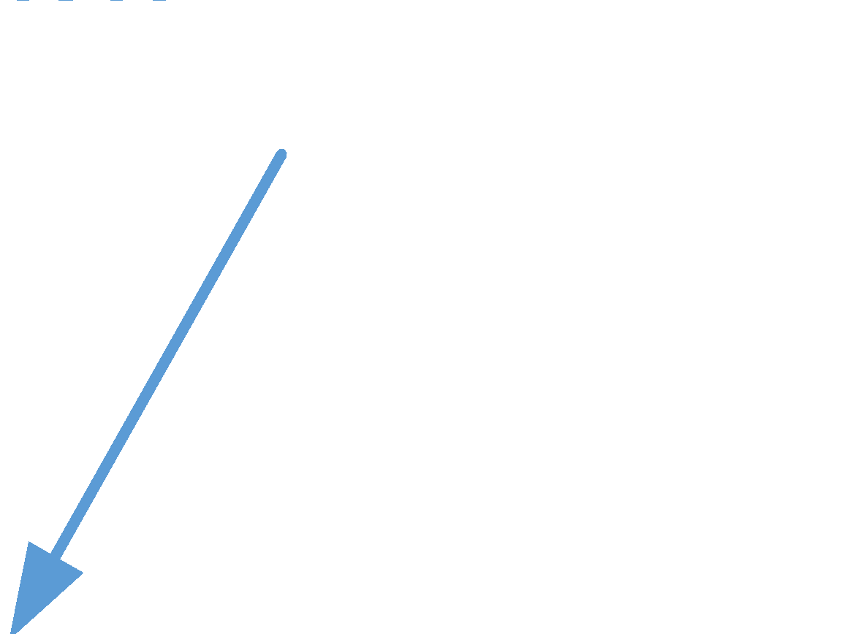


Time Aware Scheduling
Each egress-port has multiple transmission queues
Frames are sorted into queues according to their priority, e.g. by PCP of VLAN Tag
The egress post schedule has a Gate Control list which consists of Time Windows.
GCL in TSN bridges are synchronized using IEEE 802.1AS.
Time Window determines which egress queue is allowed to transmit during this window.
Queues within a time window are serviced in strict priority.
When the gate is open for a given queue, a frame is transmitted from this queue when the following conditions are met:
The queue contains a frame ready for
transmission,
higher priority trafﬁc class queues with an open gate do not have a frame to transmit, and
the frame transmission can be completed before the gate closes for the given queue.
Cyclic
execution

Slide 11
Deterministic Data Center
While significant research efforts have enhanced DCN, integrating the IEEE 802.1 TSN and IETF DetNet specifications with the enhanced DCN architectures and protocols should be explored in future research. For instance, effectively utilize the TSN flow control and management mechanisms has the potential to substantially improve the communication within and between DCNs.
This integration can provide deterministic end-2-end latency for edge computing IIOT applications.
Time synchronization is needed in Cyber-Physical Systems (CPS) for coordination of distributed inputs, outputs, computation, and communication.
We may need to explore if IEEE 802.1AS profile with the required extensions can be used to help define the Data Center IEEE 1588 Profile ?
Large Scale Deterministic Networking: A Simulation Evaluation (arXiv:1910.00162, 2019)
TSN Algorithms for Large Scale Networks: A Survey and Conceptual Comparison (arXiv:1905.08478, 2019)

Slide 12
IEEE 802.1AS (gPTP) Overview

Slide 13
What is IEEE 802.1AS ?
IEEE 802.1AS (Generalized PTP – gPTP) is the standard that specifies the requirements to allow for transport of precise timing and synchronization in any 802-compatible LAN which transports Time Sensitive Traffic.
IEEE 802.1AS includes a PTP profile of IEEE 1588-2019 that is applicable to full-duplex IEEE 802.3 transport, and adds specifications for timing transport over IEEE 802.11, IEEE 802.3 EPON, and Coordinated Shared Networks (CSN). Examples of CSN include networks that are based on MoCA or G.hn (Ethernet over Caox).
The main focus of this presentation is on transport of gPTP messages over Full-duplex Ethernet links.
The transport specific values for MAC of gPTP MAC addresses and Ethertype (x88F7) used to transport gPTP messages are specified in Annex E of IEEE 1588v2.1 (2019) and Annex F of IEEE 1588v2.
IEEE 802.1AS-Rev 2020 supports Multiple Domains to facilitate fault tolerance and redundancy for industrial and automotive applications.
IEEE 802.1 TSN TG started the work on a new amendment to IEEE 802.1AS-Rev 2020 to specify hot-standby as an option to improve fault tolerance and reliability

Slide 14
IEEE 802.1AS PTP Profile vs IEEE 1588 for Full-Duplex Ethernet
IEEE 802.1AS uses an alternate BMCA that is different from the default BMCA defined in IEEE 1588v2-2008.
IEEE 8021.1AS-2011 uses SNMP. But IEEE 802.1AS-Rev 2020 does not preclude using Netconf/Yang.
IEEE 802.1AS uses Peer Delay Mechanism as the Path Delay Mechanism.
A time-aware system is a PTP ordinary clock or boundary clock, depending on whether it has one or more than one gPTP ports, respectively.
All time-aware systems in IEEE 802.1AS-2011 are two-step clocks (as defined in IEEE 1588-2008). IEEE 802.1AS-Rev 2020 allows one step.
Each gPTP port of a time-aware system measures the frequency offset of its neighbor at the other end of the attached link relative to itself. The frequency offset, relative to the grandmaster, is accumulated in a standard organization TLV that is attached to the Follow_Up message.
A standard organization TLV is defined that allows a port of a time-aware system to request that its neighbor slow down or speed up the rate at which it sends Sync/Follw_up, Peer Delay, and/or Announce messages.
IEEE 802.1AS includes formal interface definitions for the time-aware applications. IEEE Std 1588-2008 does not define how an application provides or obtains time information.
gPTP defines a mandatory process whereby all time-aware systems in a gPTP domain are logically syntonized (i.e. they all measure time intervals using the same frequency). Syntonization in IEEE 1588v2 is optional, and the method used is not as direct and takes longer to converge. The syntonization method used by gPTP is supported as an option in IEEE Std 1588-2019, but uses a TLV standardized as part of IEEE Std 1588-2019 (this feature is new for IEEE Std 1588-2019), while gPTP uses the ORGANIZATION_EXTENSION TLV.

Slide 15
IEEE 802.1AS Performance Requirements
All Performance specifications are in Annex B.
There are no holdover specifications in IEEE 802.1AS.
The local clock frequency shall be 25 MHz or greater (i.e., the time measurement granularity is no worse than 40 ns).
The residence time (i.e., the time interval between the sending of a Sync message on a master port and receipt of the most recent Sync message on the slave port) shall not exceed 10 ms.
The Pdelay turnaround time (i.e., the time interval between the receipt of a Pdelay_Req message and the sending of the corresponding Pdelay_Resp message shall not exceed 10 ms.
The error inherent in any scheme used to measure neighbor rate ratio shall not exceed 0.1 ppm.

Slide 16
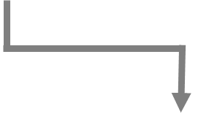
IEEE 802.1AS Synchronization Hierarchy
802.1AS endpoint
802.1AS end station
Grand Master
Time Aware Bridge
acts as PTP boundary
clock
CS
CM
Each time-aware system except the grandmaster uses incoming synchronization information on its slave port to synchronize to the grandmaster. Each time-aware system transmits synchronization information on any master port..
802.1AS
CM
802.1AS
bridge
CS
CS
CM
CM
CM
bridge
CM
clock master port
802.1AS
end station
CS
clock slave port
CS
CM
IEEE 802.1AS bridges provide timing correction information based on the delay through the link and the bridge itself.
CS
802.1AS
end station
CS
Time aware end station
acts as ordinary clock
802.1AS
end station

Slide 17
Best Master Clock Algorithm (BMCA)
The BMCA determines the grandmaster for a gPTP domain and constructs a time-synchronization spanning tree with the grandmaster as the root.
Synchronized time is transported from the grandmaster to other time-aware systems via the time-synchronization spanning tree.
Best master selection information is exchanged between time-aware systems via Announce messages. This information includes Priority, clock class, clock accuracy, and clock identity.
Each time-aware system in turn uses the information contained in the Announce messages it receives, along with its knowledge of itself, to compute which of the time-aware systems that it has knowledge of should be the root and, if grandmaster-capable (priority is < 255), the grandmaster.
Initially every time-aware system sends Announce messages, eventually the selected GM is the only one which sends Announce message.
As part of constructing the time-synchronization spanning tree, each port of each time-aware system is assigned a port role (Master, Slave, Passive, Disabled) by the state machines associated with the ports and with the time-aware system as a whole. Port is placed in Passive state to break the loop.

Slide 18
gPTP vs IEEE 1588v2 Best Master Clock Algorithm (BMCA)
The BMCA described in this standard is equivalent to a subset of the BMCA described in IEEE Std 1588-2008. It is also equivalent to a subset of the Rapid Spanning Tree Protocol (RSTP) described in IEEE Std 802.1D-2004 (RSTP may not be optimal for the transportation of time synchronization messages).
gPTP BCMA is media-independent protocol.
The BMCA used in gPTP is the same as that used in IEEE 1588 with the following exceptions:
Announce messages received on a slave port that were not sent by the receiving time-aware system are used immediately, i.e., there is no foreign-master qualification,
A port that the BMCA determines should be a master port enters the master state immediately, i.e., there is no pre_master state,
The uncalibrated state is not needed and, therefore, not used, and
All time-aware systems are required to participate in best master selection (even if it is not grandmaster capable) for fast reconfiguration when GM changes.
For description of these states refer to Table 10 in clause 9.2.5 of IEEE 1588v2 or Table 27 of the same clause in IEEE 1588-2019.

Slide 19
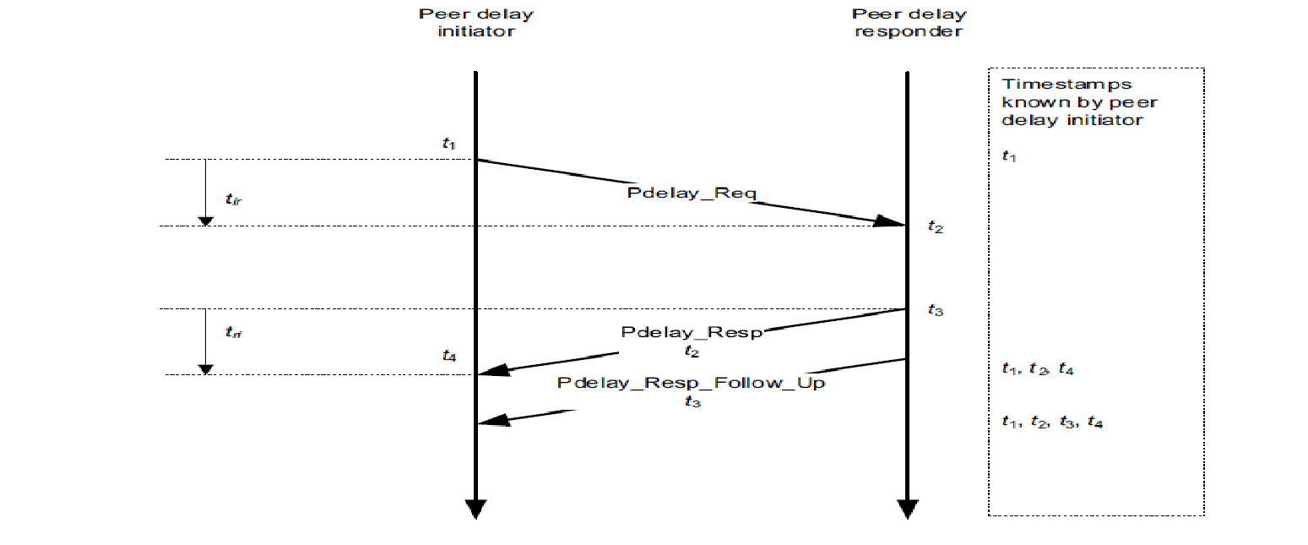
Propagation delay measurement using peer-to-peer delay mechanism
Link Delay = [(T4-T1) – (T3-T2)]/2

Slide 20
Link Propagation Delay Asymmetry
The previous equation provides mean Link delay measurements, i.e., meanLinkDelay = (tir + tri) / 2
Any asymmetry that is not corrected for introduces an error in the transported synchronized time value.
The accuracy of the mean Link delay measurement depends on how accurately the times t1, t2, t3, and t4 are measured.
The delayAsymmetry is defined as:
tir = meanLinkDelay – delayAsymmetry
tri = meanLinkDelay + delayAsymmetry
The measurement of delay Asymmetry is out of scope of this standard
This standard does not explicitly require the measurement of delayAsymmetry
DelayAsymmetry can be added to the system configuration to improve the accuracy of time synchronization.
In the case of IEEE 802.3 where the communication path is a full-duplex, point-to-point link Asymmetry correction is not needed.

Slide 21
Link Delay Error Due to Local Clock Frequency Synchronization
The Link Delay measurements assumes that the initiator and responder timestamps are taken relative to clocks that have the same frequency. In practice, t1 and t4 are measured relative to the LocalClock entity of the initiator time-aware system, and t2 and t3 are measured relative to the LocalClock entity of the responder time-aware system.
If the propagation delay measurement is desired relative to the responder time base, the term (t4 – t1) must be multiplied by the rate ratio of the responder relative to the initiator, otherwise there will be an error equal to 0.5 y, where y is the frequency offset of the responder relative to the initiator.
Likewise, if the propagation delay measurement is desired relative to the initiator time base, the term (t3 – t2) must be multiplied by the rate ratio of the initiator relative to the responder, otherwise there will be an error equal to 0.5 y, where y is the frequency offset of the initiator relative to the responder.
Finally, if the propagation delay measurement is desired relative to the Grandmaster clock time base, each term must be multiplied by the rate ratio of the Grandmaster Clock relative to the time base in which the term is expressed.
IEEE 802.1AS Text

Slide 22
gPTP Syntonization
The physical adjustment of the frequency of the LocalClock entity (i.e., physical syntonization) is allowed but not required.
Adjusting the frequency of an oscillator (e.g., using a PLL) is slow and prone to gain peaking effect
Logical Syntonization
The cumulative rateRatio is set equal to the cumulative rateRatio of the most recently received Sync and Follow_Up message on the slave port multiplied by the current neighbor rate ratio measured by the slave port.
The frequency ratio R of the Grandmaster Clock relative to the local clock is used in computing synchronized time GM (T) where T is the local time using the following equation:
GM(T) = preciseOriginTimestamp of the most recently received Sync/Follow_Up message on the slave port +
The CorrectionField of the the most recently received Sync/Follow_Up message +
Propagation Delay measured by the slave port +
R (T – local timestamp of the most recently received Sync/Follow_up message).
Advantages of Logical Syntonization
Fast convergence when GM changes, because neighbor rate ratios are measured persistently
There are no gain peaking effect, because an error in one neighbor rate ratio measurement does not affect another neighbor rate ratio measurement

Slide 23
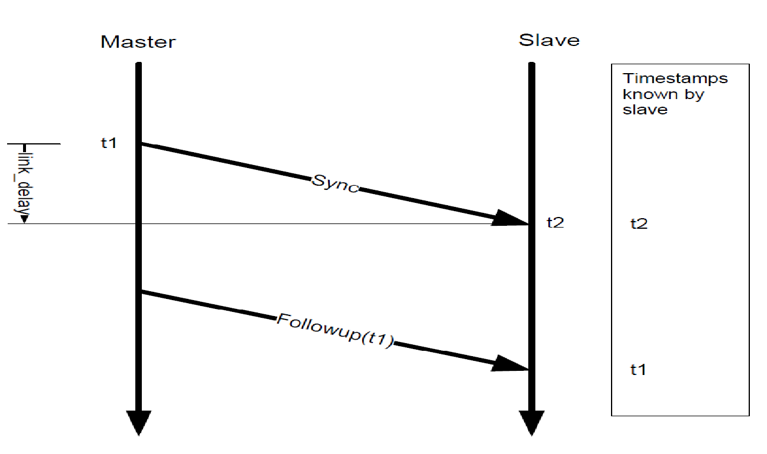
Transport of Time Synchronization Info over Full-Duplex Ethernet (IEEE 802.3)
If link delay is fixed & symmetric:
Slave’s clock offset= t2 –t1 –link_delay

Slide 24
gPTP Domain
A gPTP domain consists of one or more time-aware systems and links that meet the requirements of IEEE 802.1AS standard and communicate with each other as defined by the IEEE 802.1AS protocol.
A gPTP domain defines the scope of gPTP message communication, state, operations, data sets, and timescale.
IEEE 802.1AS-2011 allows for only one gPTP domain, namely domain 0
A time-aware system compliant with 802.1AS-2011 ignores gPTP messages that carry a domain number other than 0.
IEEE 802.1AS-Rev 2020 adds support for multiple domains.
In steady state, all time-aware systems in a gPTP domain are traceable to a single grandmaster.

Slide 25
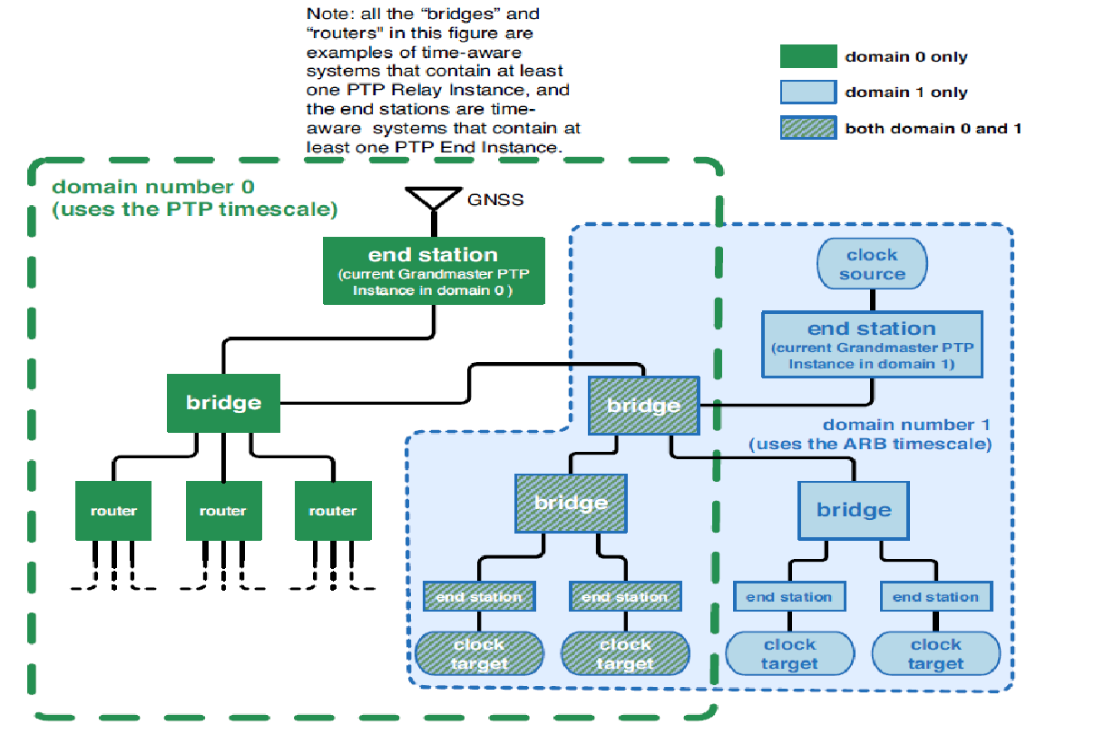
IEEE 802.1AS-Rev 2020 Multiple Domain Support
The timescale PTP: This is the elapsed time since the PTP epoch (1 January 1970 00:00:00 TAI ) measured using the second defined by International Atomic Time (TAI)
The timescale ARB: In normal operation, the epoch is set by an administrative procedure. The epoch is permitted to be reset during normal operation. Between invocations of the administrative procedure, the timescale is continuous.. The unit of measure of time is determined by the Grandmaster Clock. The second used in the operation of the protocol may differ from the SI second
IEEE 802.1AS-REV supports the option of having more than one domain, where domain number ranges from 0 to 127.
Multiple domains are supported for the following reasons:
Some applications require more than one domain (e.g., industrial networks need a universal time domain for an entire factory and a working clock domain for a group of machines that work together
Take advantages of redundant paths and GMs in IEEE 1588v2.1 with each redundant spanning tree is in a different domain to support new TSN applications which require redundancy and fault tolerance.

Slide 26
Thank You

Slide 27
IEEE 802.1AS Benefits
IEEE 802.1AS -2011 focused on the following two aspects that are important for LAN applications:
Increased Cost Savings: Use of free-running clock allows for use of low cost oscillators which are commonly used in industrial automation and in-vehicle automotive applications.
Improved Reliability: IEEE 802.1AS requires that all bridges and end stations in the network can operate the protocol. This provides consistent performance, which is essential to many local area network applications. This requirement is enforced using a media-dependent mechanism.
For example, a full-duplex Ethernet port uses the IEEE 1588 peer delay mechanism to determine whether the system at the other end of the link can respond to peer delay messages.
If a switch does not support IEEE 802.1AS, it is excluded from transporting time.
In IEEE 1588 it is possible to use non-IEEE-1588-aware Bridges in an IEEE 1588 domain, although this slows timing convergence and introduce extra jitter and wander that must be filtered by any IEEE 1588 clock.

